Slide 1
SALES DATASET ANALYSIS
ADVANCED EXCEL PROJECT
NAME : MUHAMMED ASHIF T DATE: 10-10-2025
COURSE: DATA ANALYTICS & DATA SCIENCE BATCH: AUGUST-2025

Slide 2
PROJECT OBJECTIVES AND OVERVIEW
PROJECT OBJECTIVES
To analyze sales data and generate actionable insights that drive strategic business
decisions and performance
GOALS
Tracking sales trends to identify patterns and growth opportunities
Highlighting top-performing products, categories, and channels
Analyze the impact of discounts and returns on sales and profitability
Identifying underperforming segments and suggested data-driven improvements
Delivering actionable recommendations to enhance business performance

Slide 3

DATA DESCRIPTION AND PREPARATION
DATASET OVERVIEW:
The Superstore Sales Dataset contains 9994 rows and includes 21 columns which are Row Id, Order Id, Order Date, Ship Date, Ship Mode, Customer Id, Customer Name, Segment, Country, City, State, Postal Code, Region, Product Id, Category, Sub-Category, Product Name, Sales, Quantity, Discount and Profit.
DATA CLEANING PROCESS :
Removing duplicate values and blank entries.
Handling missing values.
Correcting negative values and inconsistent data.
Formatting column names for readability.
Applying date formatting for date related columns.

Slide 4
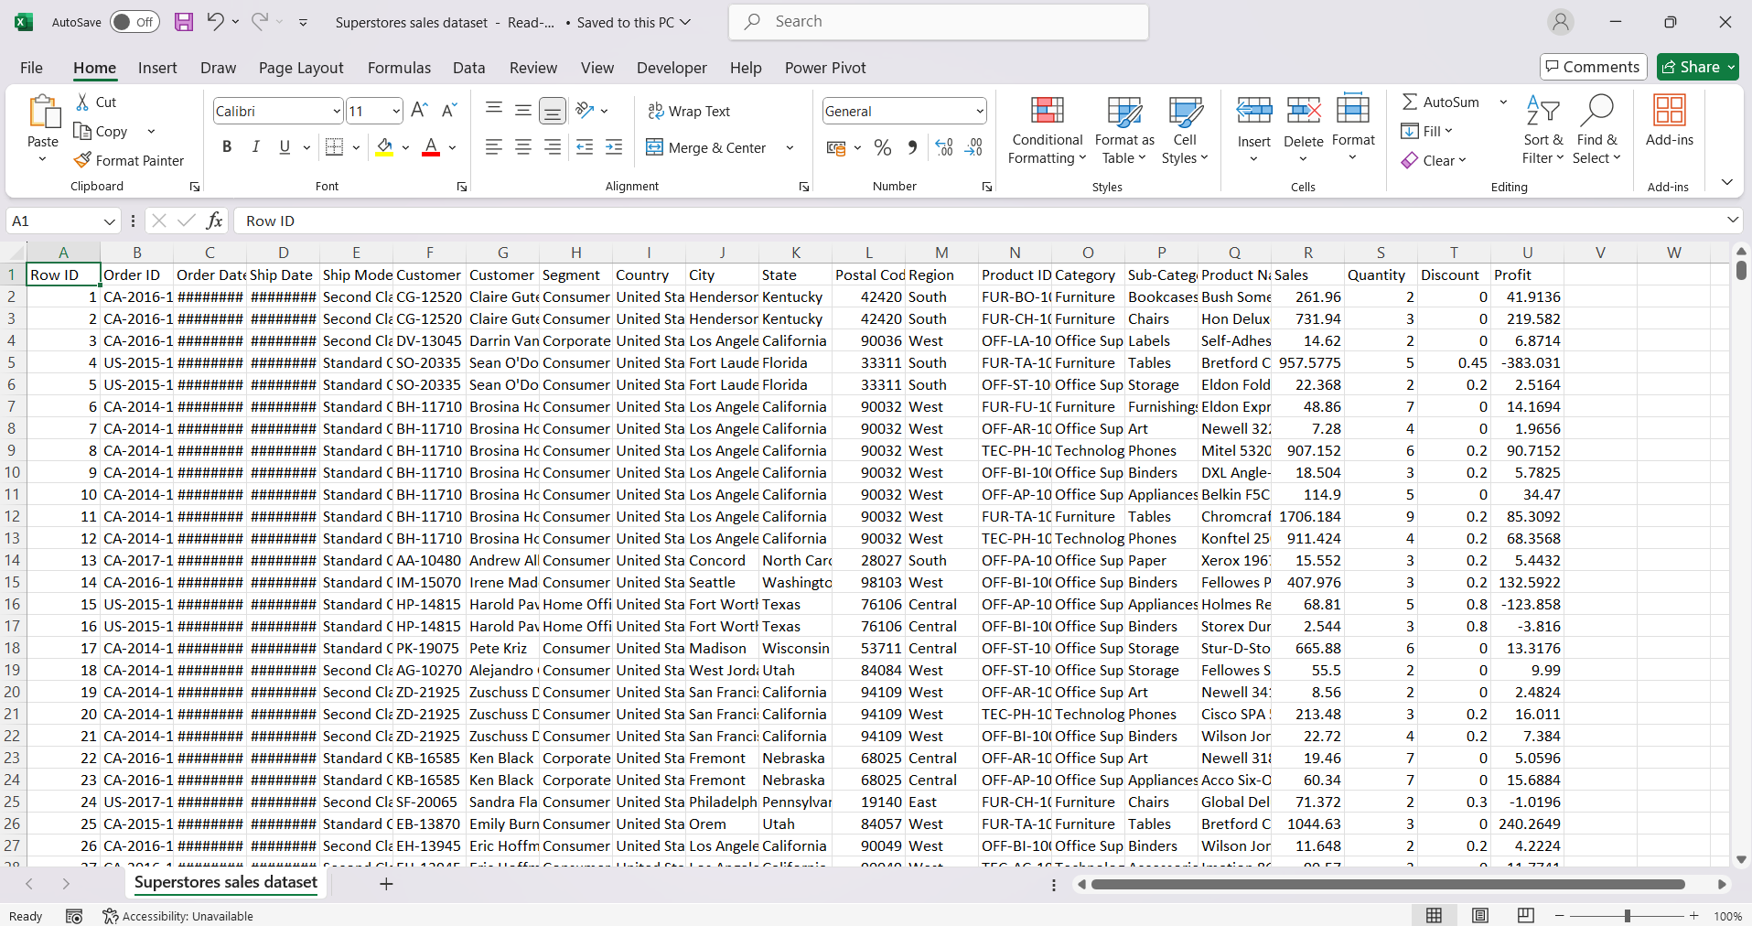
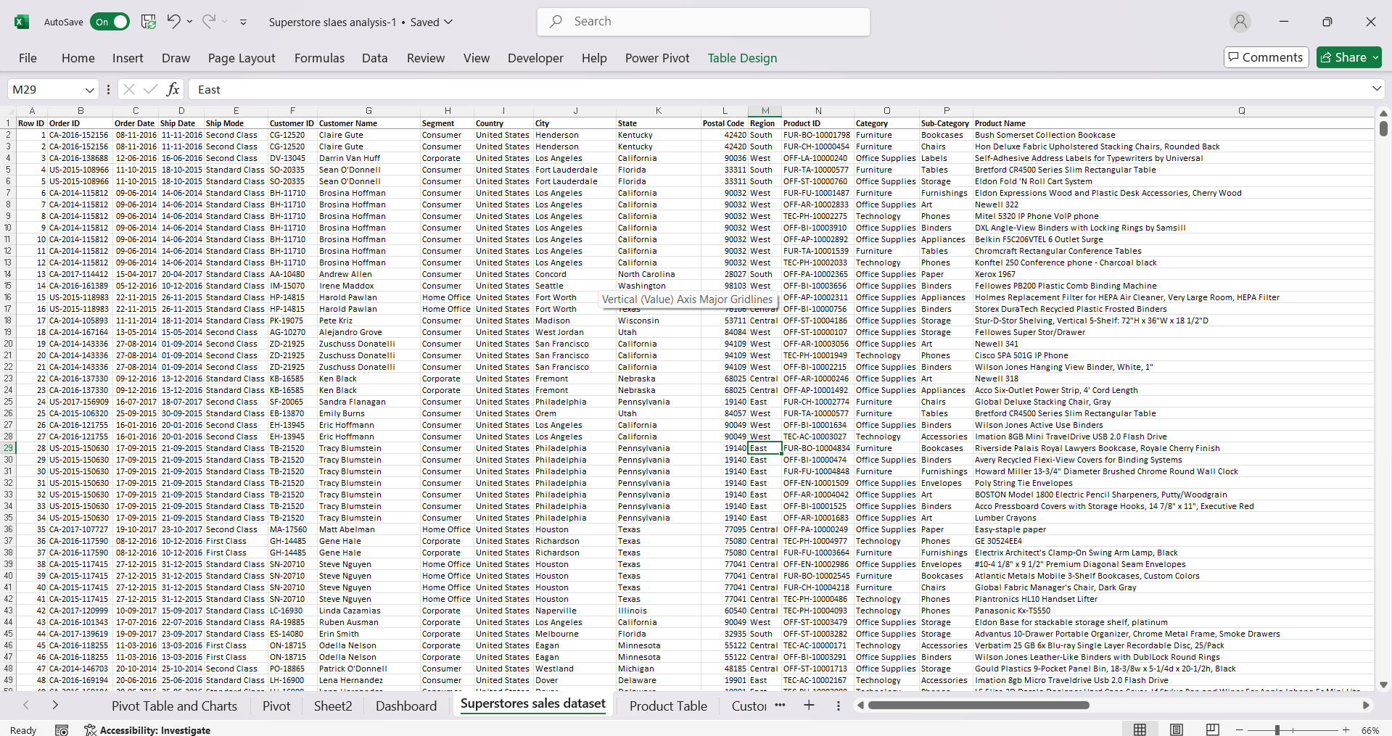
VISUALS
RAW DATA
CLEANED DATA

Slide 5
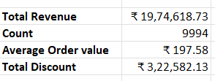
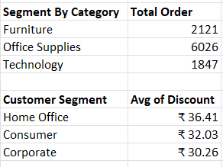
KEY METRICS AND DATA ANALYSIS
Key Metrics
TOTAL REVENUE = SUM(ADJUSTED SALES)
TOTAL COUNT = SUM(ADJUSTED SALES)
AVERAGE SALES = AVERAGE(ADJUSTED SALES)
TOTAL DISCOUNT VALUE = SUM (DISCOUNT VALUE)
SALES BY CHANNEL/PRODUCT TYPE
COUNTIF = Calculate the Total Order
AVERAGEIF = Calculate the Average Discount

Slide 6
PIVOT TABLES AND PIVOT CHARTS
Pivot Table Summary :
PivotTables enabled multidimensional analysis of sales data, facilitating a detailed examination by channel, product type, and time period. Through aggregation, grouping, and filtering, large datasets were efficiently summarized to identify key trends and revenue drivers. These insights played a vital role in guiding data-driven strategic decisions.
Pivot Chart Visualizations :
The implementation of PivotCharts enabled a comprehensive visualization of sales patterns across time and product categories. Through comparative and trend-based analysis, the charts revealed variations in performance. This visual representation transformed raw data into actionable insights, facilitating informed and strategic business planning.

Slide 7
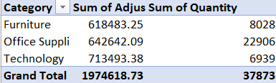
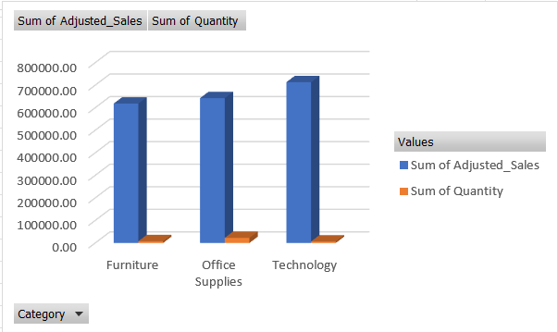
PIVOT TABLES AND PIVOT CHARTS
VISUALS
Pivot Table
Pivot Chart

Slide 8
DASHBOARD OVERVIEW
The Dashboard is designed to deliver an interactive overview of key business metrics using visualization charts.
We also use interactive filters like Slicers to quickly and dynamically segment data for more focused data analysis.
Key Performance Indicators (KPI):
Total Sales
Best Selling Products
Average Order Value
Total Discount
Total orders

Slide 9
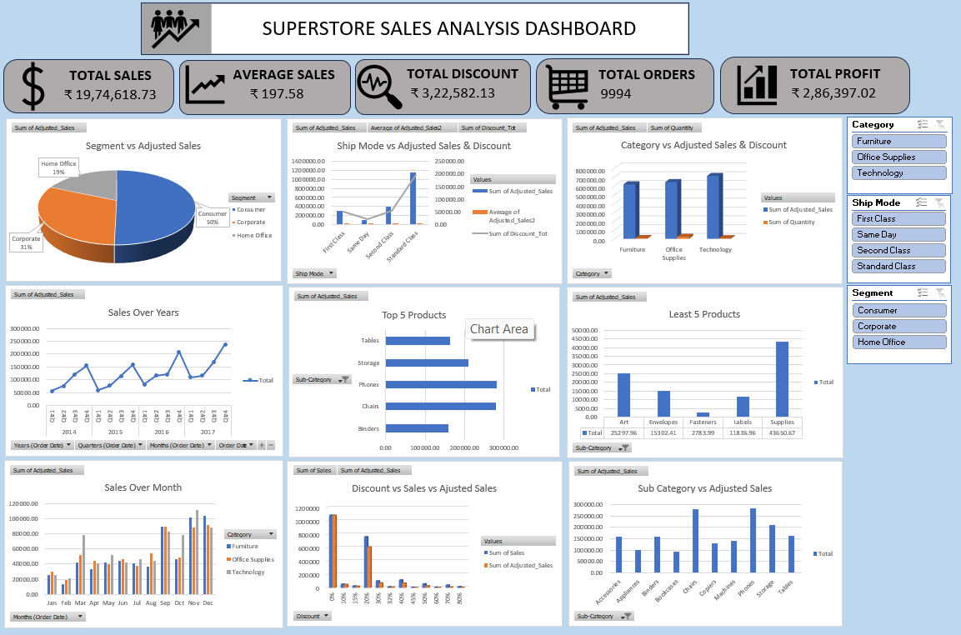
SUPERSTORE SALES DASHBOARD

Slide 10
WHAT-IF ANALYSIS
Objective
To determine the required quantity of Furniture items needed to achieve a total sales target of ₹7,00,000.
Initial Data:
Price per unit: ₹ 77.04,
Initial Quantity: 8028 units ,
Initial Sales: ₹6,18,483.25
Method Used:
Excel’s Goal Seek feature was applied with the following parameters:
Set Cell: D6 (Furniture Sales)
To Value: ₹7,00,000
By Changing Cell: C6 (Quantity)
Result:
Updated Quantity: 9086.09 units
Updated Sales: ₹7,00,000

Slide 11
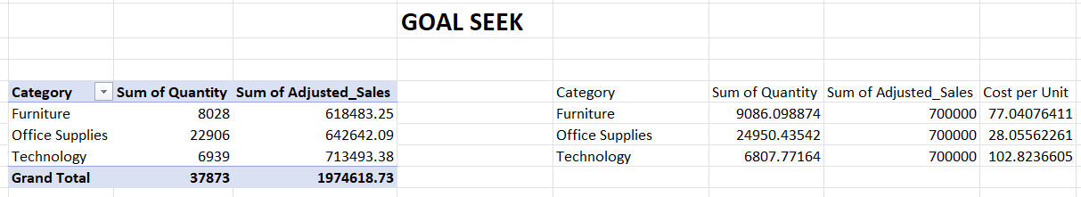
GOAL SEEK

Slide 12
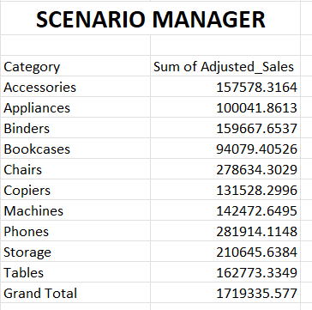
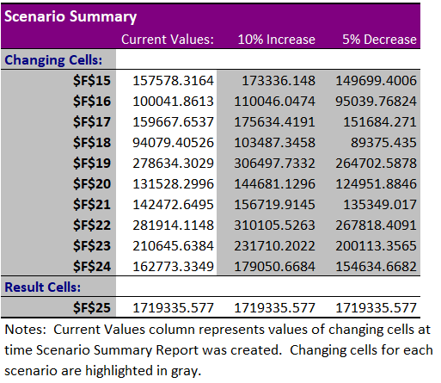
SCENARIO MANAGER
The report shows how different sales changes affect revenue.
Sales +10% → Highest revenue, up by ₹1710933.55774
Discount -5% → Revenue decreases by ₹85996.77872

Slide 13
MACROS AND AUTOMATION
Macro Recording :
Macros are used to automate repetitive tasks within Excel.
Macros operate by recording the user’s actions like formatting, report generation calculation etc.
In Excel, macros reside within the workbook, however, to maintain and execute them, the file must be saved as a macro-enabled workbook (.xlsm).
Benefits :
By using Macros Saved time, improved efficiency, ensured consistency, made data analysis faster and more efficient.
Also, with the help Button where we can save macro in that button, and within a click the task is done.

Slide 14
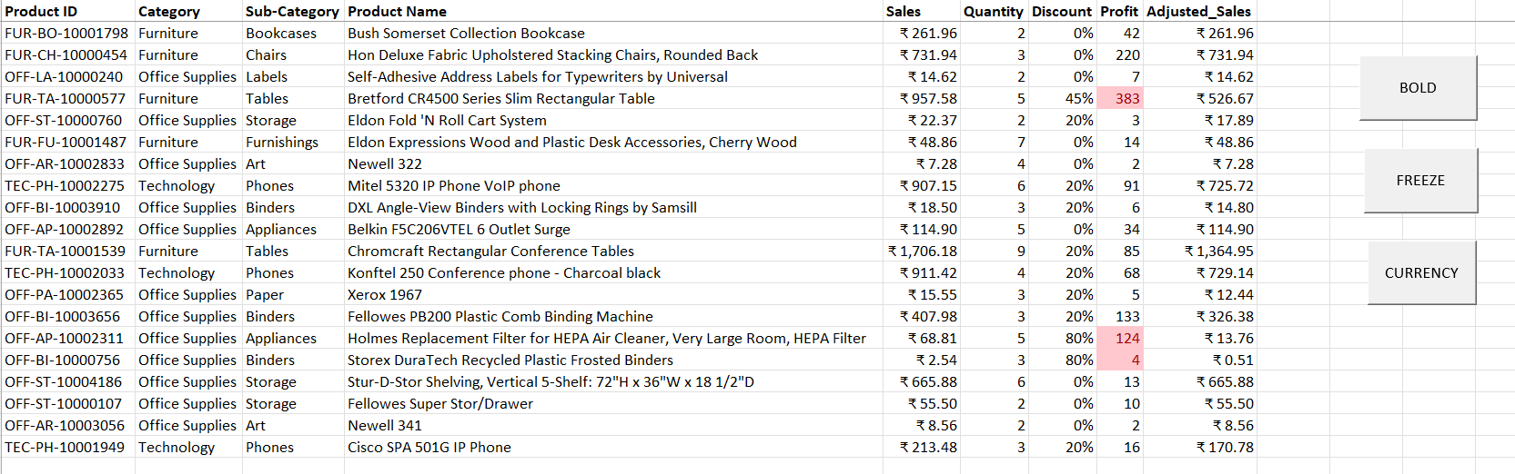
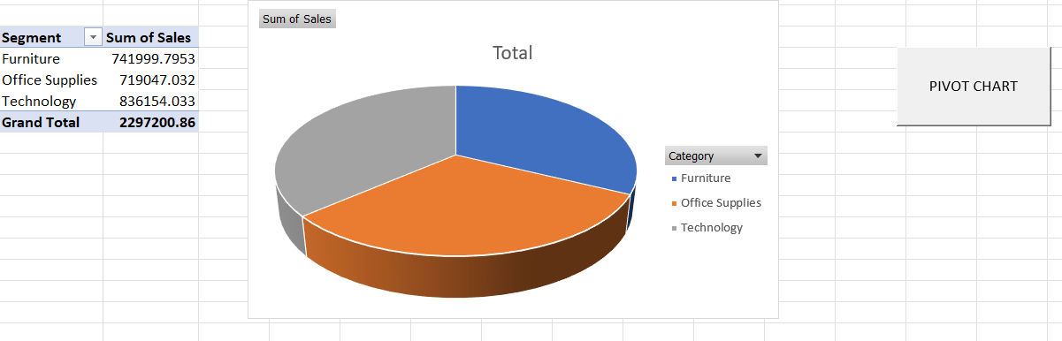
VISUALS

Slide 15
INSIGHTS AND RECOMMENDATIONS
Analyzed top-performing categories, revealing Technology and Office Supplies as major revenue drivers.
Identified Consumers as the strongest segment, generating 50% of the sales.
Discovered year-around growth with peak performance in Q4 due to festive season demand
There is significant increase in Sales is after 2015 and reached its maximum peak in 2017.
Found out Standard Class is the most preferred shipping mode.
Recommended improving underperforming accessories through bundling or repositioning.
Recommended improving underperforming products by repositioning and advertising.

Slide 16
RECOMMENDATIONS
Optimize pricing strategies by reducing unnecessary discounts.
Increase promotion for slower-moving categories such as Furniture.
Prioritize key clients with high-demand Technology products.
Enhance product turnover through strategic advertisement and pricing adjustments.
Implement customer loyalty programs and promotional offers (Vouchers).
Streamline delivery processes to improve efficiency and customer satisfaction.

Slide 17
CONCLUSION
The Superstore Dashboard provides actionable insights to optimize pricing, focus on best-selling products, improve delivery efficiency, strengthening customer loyalty, and leverage seasonal and regional trends to drive growth and profitability.
NEXT STEPS :
Sales Forecasting: Project Q1,Q2 sales to optimize inventory planning and promotional activities.
Product Strategy: Develop bundling initiatives to improve turnover of low-performing accessories.
Regional Insights: Analyze customer behavior by region to tailor sales and marketing strategies.
Discount Analysis: Assessing how current discount structures influence profit margins.

